Slide 1

Final Project – DERIV2D
COSC 6364 – Advanced numerical analysis
By: hai-y Michael Tran Nguyen – 0925358
5/10/2018

Slide 2
Introduction
The goal of this project is to extract derivatives and gradients of multidimensional functions and compare them. Specifically, we will numerically calculate the directional derivative of a Function A and compare it to another Function B (which is already the derivative). In this project, we will be doing this on 2D functions.

Slide 3
Technologies Used
C# - MS Visual Studio 2018
Part 1 – Mainly deals with calculating the derivative and generating and outputting the raw data (.csv) used for comparison in part 2
R – R Studio
Part 2 – Mainly deals with running comparison and creating graphs based on the raw data generated from Part 1

Slide 4
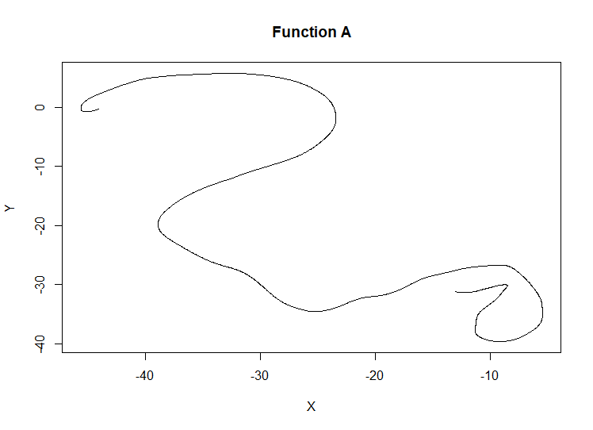
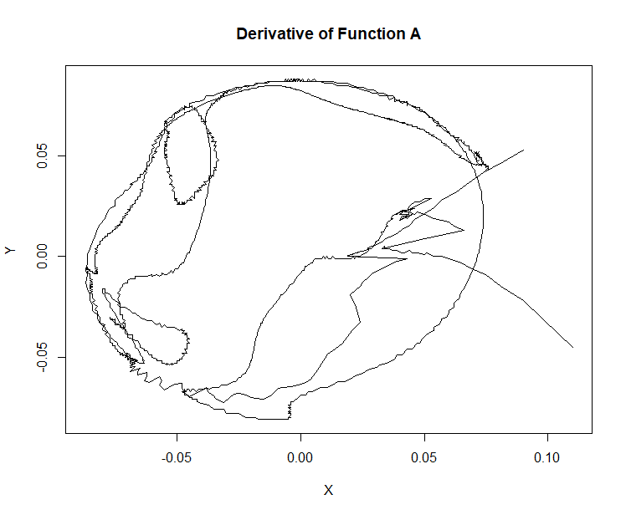
Function A Graph

